Slide 1
Olympic Medal Count vs Socioeconomic Factors
By: Leidy Dorando-Munos, Joe Antoniotti, Brett O’Malley, and Ahmad Javed

Slide 2
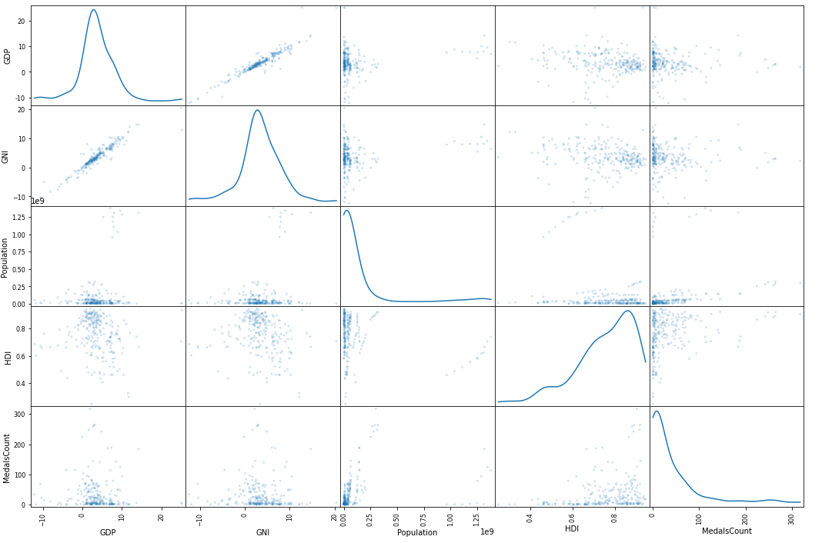
Selected topic
The topic we have selected for this project is to look at the correlation and/or causation between different socioeconomic factors of a country and how that same country fairs in the summer olympic games from 1990 - 2020
Figure 1. Multiple scatter plots comparing different factors and indicators across all countries that competed in the olympic games

Slide 3
Reason why they selected their topic
One reason we have selected this topic is that it allows us to use the tools and lessons we have learned over the course of the this bootcamp to create a data science project that includes:
Creating a database
Using machine learning to analyse our data
Using machine learning to create a predictive model based on our data
Another reason we have selected this topic is to understand what causes certain countries to excel at the summer olympic games, and what factors may hinder a country's chances before they even partake in their first event

Slide 4
Description of their source of data
There are three main sources of data we are using for this project
The World Bank Catalog
The HDI Index
The Medal Count per country for the summer olympic games

Slide 5
Questions they hope to answer with the data
The main question we wish to tackle is to see how different country based factors could impact the performance of different countries at various olympic games
These factors can be broken down into any of the following categories:
Economic
Social
Political
The second question we wish to answer is to see if we can predict how a country is going to perform at the next olympic games based on their current socioeconomic factors, as well as other indicators that make up a countries HDI ranking

Slide 6
Description of the data exploration phase of the project
There are multiple factors that make up the HDI Ranking ( i.e life expectancy, the standard of living, life health expectancy, schooling years, etc.) which are combined with other socioeconomic indicators such as GDP, GNI, and Population
When these factors are combined with the medal count of a country, the goal is to compare either HDI, GDP, GNI, and Population (during a year in which the olympics are held) to the medal count of a country to see if there is a positive, negative, or null correlation between the two factors
To analyze this data even further, we will be specifically looking at how many times a country finished in the top 15 for each game as well, to get a better idea of the effect that these factors may have on performance

Slide 7
Description of the analysis phase of the project
The analysis phase of the the project is split up into two main parts:
The World Bank & HDI factors are grouped together via a dataframe based on specific years in which the games were held
Once these factors are stored, a scatter plot is created in order to analyze what are the possible relationships between individual factors
The main goal is to see how the factors influence the medal count of a country during the olympics
A further analysis will be done to see how many times countries finished in the top 15 for all events, as well as how many medals each country received during each individual olympic games

